Slide 1
Practical Malware Analysis
Chapter 2: Malware Analysis in Virtual Machines
Chapter 3: Basic Dynamic Analysis
2026/01/07
Taeyoung Kim

Slide 2
Chapter 2: Malware Analysis in Virtual Machines
Why Virtual Machines for Malware Analysis?
Malware analysis inherently involves executing untrusted and hostile code
Running malware on a host OS risks:
  Permanent system compromise (historically mitigated via disk imaging tools)
  Data leakage or lateral infection
Virtual Machines (VMs) provide:
  Strong isolation from the analyst’s environment
  Reversible execution through snapshots
VMs are not optional. They are the foundation of safe analysis.

Slide 3
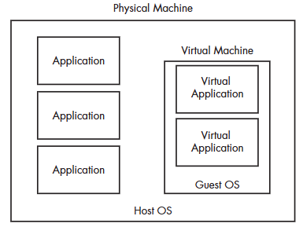
Chapter 2: Malware Analysis in Virtual Machines
Structure of a Virtual Machine
Host OS
: The analyst’s primary OS running on physical hardware
Hypervisor
: A virtualization layer that manages and isolates VMs
: Responsible for CPU, memory, disk, and device virtualization
Guest OS
: The OS running inside the VM
: Typically Windows 7/10/11 for malware analysis
Malware executes inside the Guest OS,
isolated from the Host OS by the hypervisor

Slide 4
Chapter 2: Malware Analysis in Virtual Machines
Malware Anlaysis Machine Setup
1. Choose a Hypervisor
A hypervisor provides the virtualization layer for malware analysis
Common options: VMware (Workstation/Fusion), VirtualBox, Hyper-V
VMware is commonly used due to:
  Stable snapshot support
  Broad tool compatibility

Slide 5
Chapter 2: Malware Analysis in Virtual Machines
Malware Anlaysis Machine Setup
1. Choose a Hypervisor
2. Create a Dedicated Analysis Environment
Use a separate, cleanly installed OS
  Most malware and analysis tools run on Windows
Virtual disks can be configured with dynamic allocation
  For example, a 20GB virtual disk only consumes actual space as data is written
  20GB is usually sufficient as a starting point

Slide 6
Chapter 2: Malware Analysis in Virtual Machines
Malware Anlaysis Machine Setup
Purpose | Tools
Initial Triage & File Identification | Antivirus, Hashing, PEiD
Executable Structure Analysis | PEview, Resource Hacker, Dependency Walker
Dynamic Behavior Monitoring | Process Monitor, Process explorer, Regshot
Network Communication Analysis & Control | Wireshark, ApateDNS, Netcat, INetSim
Reverse-Engineering & Debugging | IDA Pro, OllyDbg, WinDbg
1. Choose a Hypervisor
2. Create a Dedicated Analysis Environment
3. Install Analysis Applications
Install any required applications
VMware Tools improve usability
  Better mouse and keyboard interaction
  Shared folders and clipboard support
Convenience features should be used carefully!

Slide 7
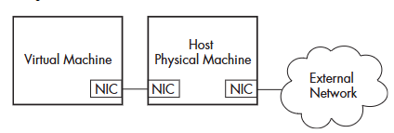
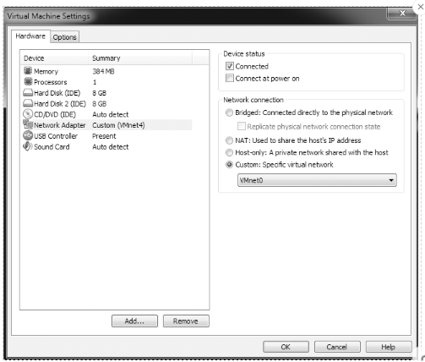
Chapter 2: Malware Analysis in Virtual Machines
Network Configuration for Isolation
Host-Only:
  Isolates the VM from external networks
  Useful for initial execution without network interaction
NAT (Network Address Translation):
  Allows the guest to access the host’s network and the Internet
  Prevents inbound connections from external networks
  Commonly used for controlled dynamic analysis
Bridged:
  Directly connects the VM to the physical network
  Exposes the VM to real network traffic and potential abuse
  Generally discouraged for malware analysis
Network access can be disabled by removing or
disconnecting the virtual network adapter

Slide 8
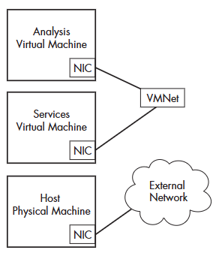
Chapter 2: Malware Analysis in Virtual Machines
Network Configuration for Isolation
Multiple VMs are connected through an isolated virtual LAN
  The network is disconnected from the Internet and the host system
Malware perceives an active network environment, while remaining isolated from external infrastructure
Analysis and service VMs are connected to the same VMnet,
acting as a private virtual switch
Using Multiple Virtual Machines

Slide 9
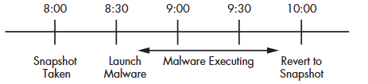
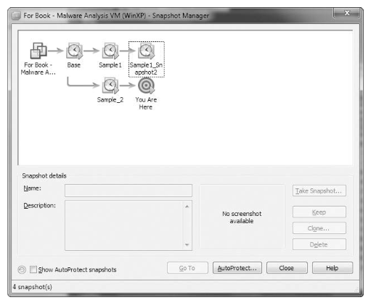
Chapter 2: Malware Analysis in Virtual Machines
Taking Snapshots
The ‘undo’ button for malware analysis
  Captures the entire state of the VM
  (memory, disk, settings) at a specific point in time
Pre-Analysis Snapshot:
Always take a snapshot before executing malware
Post-Analysis Revert:
Revert to a clean snapshot after analysis
Multiple Snapshots:
Maintain snapshots at different stages
(e.g., clean OS, OS with analysis tools installed,
pre-malware execution)

Slide 10
Chapter 2: Malware Analysis in Virtual Machines
Risks and Limitations of VM-Based Analysis
Anti-VM Techniques
  Sophisticated malware can detect when it is running inside a VM
  Behavior may change to evade analysis => Chapter 17
  (e.g., not executing, showing benign behavior)
VM Escapes
  Rare but critical vulnerabilities may allow malware to escape the VM
  Keeping the hypervisor and guest OS up to date is essential
Configuration Errors
  Misconfigured network settings or share resources (e.g., shared folders, clipboard) can compromise isolation

Slide 11
Chapter 3: Basic Dyamic Analysis
What is Basic Dynamic Analysis?
Analyze malware by executing it in a controlled environment and observing its behavior at runtime (rather than internal implementation)
Goal:
  Understand what the malware actually does on a system
  Identify observable effects such as
    File system changes
    Registry modifications
    Network communications
    Process creation

Slide 12
Chapter 3: Basic Dyamic Analysis
Basic Dynamic Tools In Practice: A Workflow
Environment Preparation
  Set up a clean VM and take a snapshot
Initial Triage (Optional)
  Use online or local sandboxes for a quick overview (e.g., VirusTotal, Cuckoo)
Pre-Execution Inspection
  Collect static hints using strings, PEiD, Dependency Walker
Baseline Snapshot
  Capture initial system state (e.g., Regshot)
Controlled Execution
  Execute the malware inside the VM, and enable network simulation if needed
Real-TIme Monitoring
  Observe behavior using Process Monitor and Process Explorer
  Capture network traffic with Wireshark
Post-Execution Analysis
  Compare system state changes and correlate findings across tools

Slide 13
Chapter 3: Basic Dyamic Analysis
Basic Dynamic Tools In Practice: A Workflow
Environment Preparation
  Set up a clean VM and take a snapshot
Initial Triage (Optional)
  Use online or local sandboxes for a quick overview (e.g., VirusTotal, Cuckoo)
Pre-Execution Inspection
  Collect static hints using strings, PEiD, Dependency Walker
Baseline Snapshot
  Capture initial system state (e.g., Regshot)
Controlled Execution
  Execute the malware inside the VM, and enable network simulation if needed
Real-TIme Monitoring
  Observe behavior using Process Monitor and Process Explorer
  Capture network traffic with Wireshark
Post-Execution Analysis
  Compare system state changes and correlate findings across tools

Slide 14
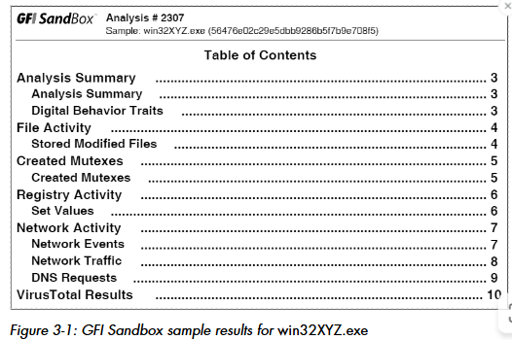
Chapter 3: Basic Dyamic Analysis
The Quick & Dirty Approach: Sandboxes
Fully automated environments that execute malware and report on its behavior (e.g., Cuckoo Sandbox, Any.Run, VirusTotal)
Advantages:
  Speed: Rapid initial assessment
  Scalability: Analyze large volumes of samples
  Simplicity: Minimal manual effort required
Drawbacks:
  Evasion: Malware can detect sandboxes and alter behavior (e.g., sleeping, self-delete)
  Limited Depth: Subtle or complex behaviors may be missed
  Lack of Control: Less interactive than manual dynamic analysis

Slide 15
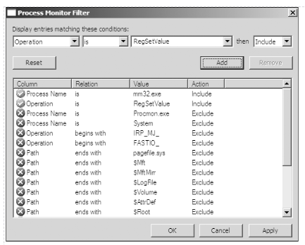
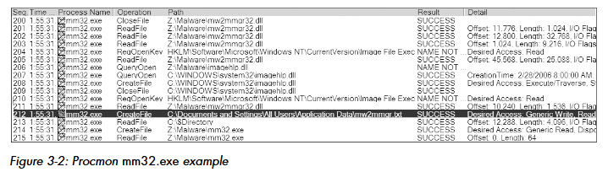
Chapter 3: Basic Dyamic Analysis
Monitoring Processes & File System with Procmon
Process Monitor (Procmon)
Captures real-time activity across:
  File system
  Registry
  Process and thread operations
Records detailed event information:
  Operation (Read, Write, Create, Delete)
  Path and result
  Process name and PID
Filtering is essential due to the high volume of events
  Common filters include process name, path, operation, and result

Slide 16
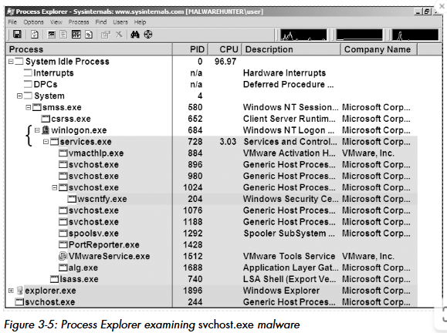
Chapter 3: Basic Dyamic Analysis
Deep Dive into Processes with Process Explorer
Process Explorer
Provides detailed information about running process
Includes parent-child relationships, CPU/memory usage, loaded DLLs, and open-handles
Key Capabilities
  Process Tree:
  Visualizes process hierarchies to identify suspicious spawns
  DLLs & Handles View:
  Shows all loaded modules and open file/registry/network handles
  Verify Signatures:
  Quickly check whether binaries are legitimately signed
  String Comparison:
  Searches for suspicious strings in a process’s memory or on disk

Slide 17
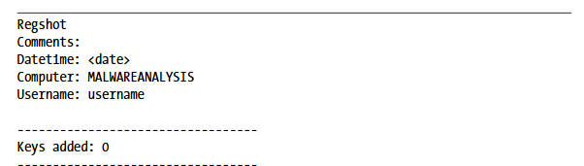
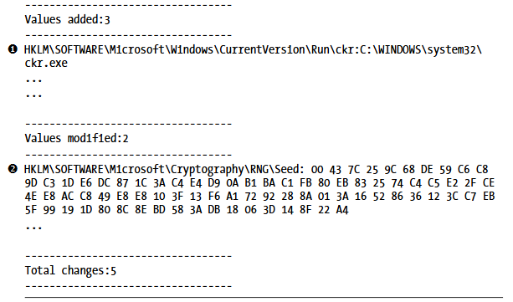
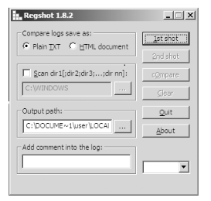
Chapter 3: Basic Dyamic Analysis
Tracking Registry Changes with RegShot
RegShot
Compares two registry snapshots taken at different times and reports the differences (added, deleted, modifed keys/values)
Workflow
  Take a baseline snapshot (clean state)
  Execute the malware
  Take a second snapshot and compare the results
Particularly useful for identifying persistence mechanisms

Slide 18
Chapter 3: Basic Dyamic Analysis
Monitoring Network Activity
Wireshark
Packet-sniffing tool for capturing and analyzing network traffic
Identifies C2 communication, data exfiltration, protocol usage, and obfuscated traffic patterns
Display filters help isolate relevant traffic quickly

Slide 19
Chapter 3: Basic Dyamic Analysis
Faking Network Activity
ApateDNS
Forwards DNS request to a local DNS server
Allows analysts to control DNS responses (e.g., redirecting malware to a fake C2 server)
Netcat
A versatile network utility used for reading from and writing to network connections.
Useful for catching incoming connections or sending test data
INetSim
Simulates common Internet services (HTTP, DNS, FTP, SMTP, IRC)
Allows malware to interact with fake services as if they were real, enabling full communication without Internet access

Slide 20
Chapter 3: Basic Dyamic Analysis
Limitations & Challenges
Anti-Dynamic Analysis Techniques
  Malware can detect dynamic analysis tools or VM environments and refuse to execute or alter its behavior
Time-Based Triggers
  Malware may activate only after a specific date or time, making analysis difficult without time manipulation
Event-Based Triggers
  Requires specific user interaction (e.g., clicking a button, opening a specific file) that might not be replicated in an automated sandboxes

Slide 21
Wrapping Up
Virtual machines enable safe and controlled malware analysis
- Proper VM configuration is essential for reliable results
Sandboxes support fast initial triage
– But manual analysis is required for deeper understanding
Basic dynamic analysis observes runtime behavior
– Processes, registry, file system, and network activity
Environmental dependencies limit basic techniques
– Motivating more advanced analysis
What‘s Next?
Part 2: Advanced Static Analysis (Chapters 4–7)
– Disassembly, IDA Pro, and understanding Windows malware at the code level
Part 3: Advanced Dynamic Analysis (Chapters 8–10)
– Debugging with tools such as OllyDbg and WinDbg
Part 5: Anti-Reverse-Engineering (Chapters 15–18)
– Anti-debugging, anti-VM techniques, and packing

